Slide 1

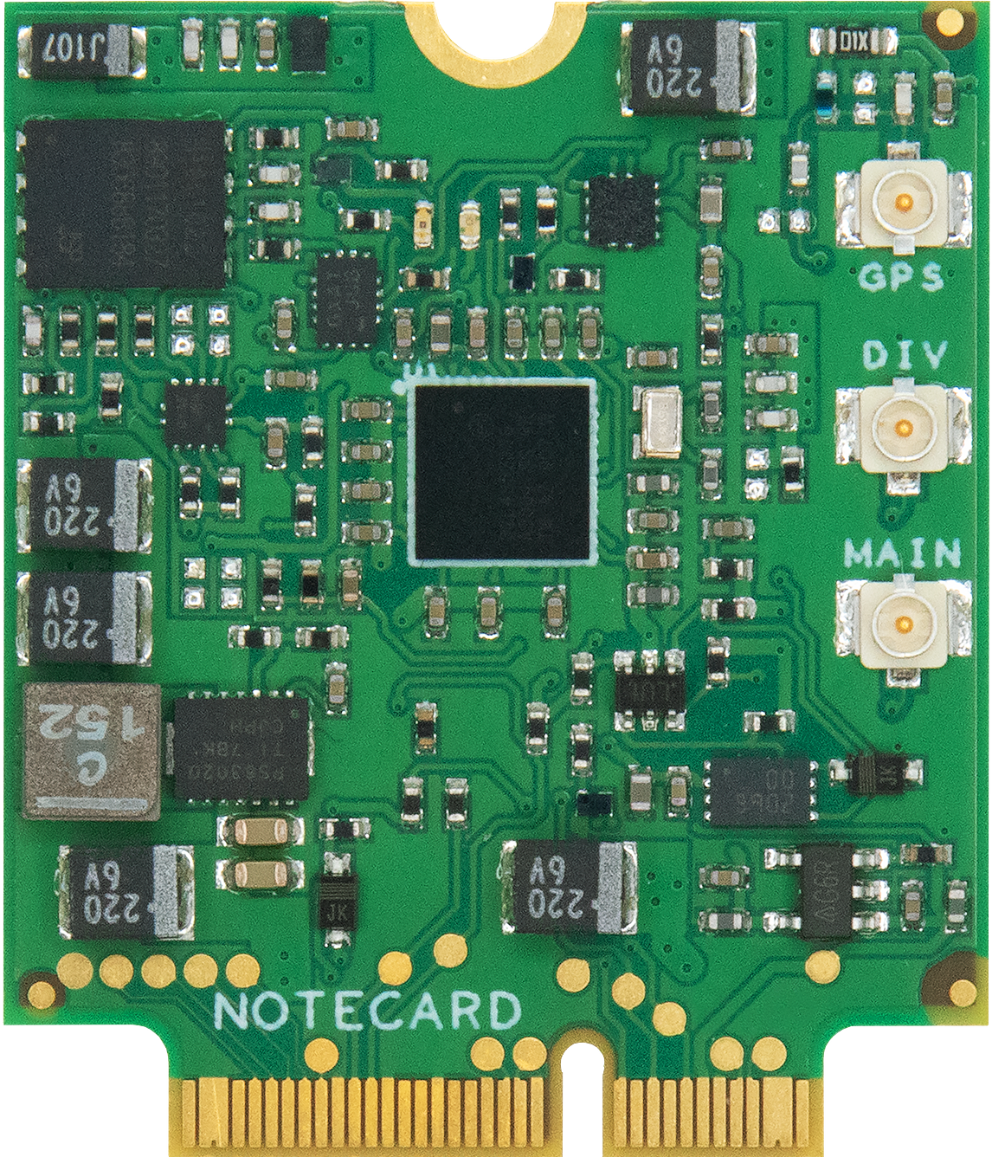
Deep Learning & Convolutional Neural Networks

Slide 2

Algorithms vs. Predictions
“Learning” Happens Here
Notes:
ML, on the other hand, works differently. In this case, we provide a series of inputs and expected outputs, and we ask the computer to produce the algorithm, which we often call a model.

Slide 3
Deep Learning: Finding Correlation among Complex Data
Notes:
http://storybydata.com/datacated-weekly/limits-of-data-hungry-deep-learning/
Finally, Deep Learning is a subset of ML that is perfect for making sense out of large amounts of complex data.

Slide 4
Deep Learning as Feature Extraction
Notes:
https://www.pnas.org/content/116/4/1074
It does so by using a layered approach to simplify complex datasets until the parts of that data that matter to learning the algorithm, (called features) emerge, and a model can be created or refined.

Slide 5
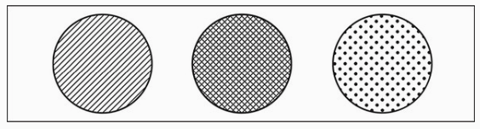

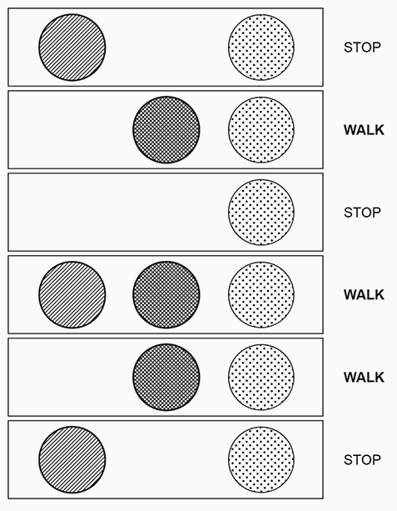

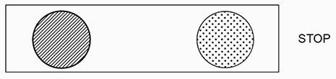
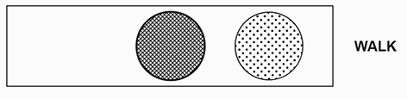
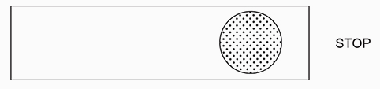

The Streetlight Problem
Some combination of these three lights tells us when its safe to walk or stop
After a few rounds, a human can infer that the middle light is the key
Examples and images from “Grokking Deep Learning” by Andrew Trask
Notes:
My favorite explanation of Machine Learning in general, and the subset of Deep Learning specifically comes from Andrew Trask’s book “Grokking Deep Learning.” Let’s pretend we find ourselves in a place where the stoplights at each intersection are completely unfamiliar to us. When we come to one of these, we pause and observe several interactions and how pedestrians react to the lights. After a handful of observations, we can probably infer the answer. Our brains are very good at observing patterns and finding correlation.

Slide 6
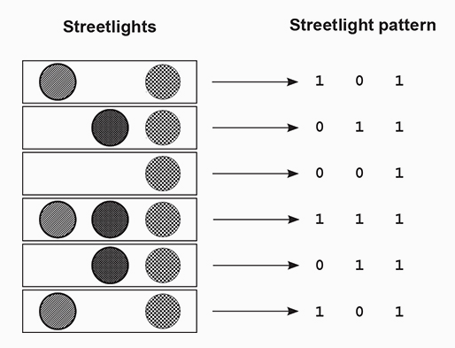
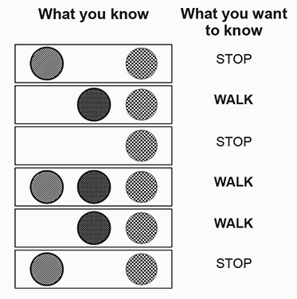
Deep Learning = Teaching Computers to find correlation
Examples and images from “Grokking Deep Learning” by Andrew Trask
Notes:
As it turns out, at its core, this is all Machine Learning is: providing a set of inputs and outputs, and devising approaches (architectures, parameters, and tuning) to help the machine learn the right correlation to be able to predict future answers with as small an error as possible. Many of the buzzwords around ML, and DL, CNNs, RNNs, etc. describe nothing more than differing approaches for helping computers find the most accurate correlations, as fast as possible.

Slide 7
Deep Learning = Teaching Computers to find correlation
import numpy as np
weights = np.array([0.5, 0.48, -0.7])
alpha = 0.1
streetlights = np.array([[1, 0, 1],[0, 1, 1],[0, 0, 1],[1, 1, 1],
[0, 1, 1],[1, 0, 1]])
walk_vs_stop = np.array([0, 1, 0, 1, 1, 0])
input = streetlights[0]
goal_prediction = walk_vs_stop[0]
for iteration in range(40):
error_for_all_lights = 0
for row_index in range(len(walk_vs_stop)):
input = streetlights[row_index]
goal_prediction = walk_vs_stop[row_index]
prediction = input.dot(weights)
error = (goal_prediction - prediction) ** 2
error_for_all_lights += error
delta = prediction - goal_prediction
weights = weights - (alpha * (input * delta))
print("Prediction:" + str(prediction))
print("Error:" + str(error_for_all_lights) + "\n")
Examples and images from “Grokking Deep Learning” by Andrew Trask
Notes:
As it turns out, at its core, this is all Machine Learning is: providing a set of inputs and outputs, and devising approaches (architectures, parameters, and tuning) to help the machine learn the right correlation to be able to predict future answers with as small an error as possible. Many of the buzzwords around ML, and DL, CNNs, RNNs, etc. describe nothing more than differing approaches for helping computers find the most accurate correlations, as fast as possible.

Slide 8
Deep Learning = Teaching Computers to find correlation
import numpy as np
weights = np.array([0.5, 0.48, -0.7])
alpha = 0.1
streetlights = np.array([[1, 0, 1],[0, 1, 1],[0, 0, 1],[1, 1, 1],
[0, 1, 1],[1, 0, 1]])
walk_vs_stop = np.array([0, 1, 0, 1, 1, 0])
input = streetlights[0]
goal_prediction = walk_vs_stop[0]
for iteration in range(40):
error_for_all_lights = 0
for row_index in range(len(walk_vs_stop)):
input = streetlights[row_index]
goal_prediction = walk_vs_stop[row_index]
prediction = input.dot(weights)
error = (goal_prediction - prediction) ** 2
error_for_all_lights += error
delta = prediction - goal_prediction
weights = weights - (alpha * (input * delta))
print("Prediction:" + str(prediction))
print("Error:" + str(error_for_all_lights) + "\n")
Prediction: -0.19999999999999996
Prediction: -0.19999999999999996
Prediction: -0.5599999999999999
Prediction: 0.6160000000000001
Prediction: 0.17279999999999995
Prediction: 0.17552
Error: 2.6561231104
…
Prediction: -0.0022410273814405524
Prediction: 0.9978745386023716
Prediction: -0.016721264429884947
Prediction: 1.0151127459893812
Prediction: 0.9969492081270097
Prediction: -0.0026256193329783125
Error:0.00053373677328488
Examples and images from “Grokking Deep Learning” by Andrew Trask
Notes:
As it turns out, at its core, this is all Machine Learning is: providing a set of inputs and outputs, and devising approaches (architectures, parameters, and tuning) to help the machine learn the right correlation to be able to predict future answers with as small an error as possible. Many of the buzzwords around ML, and DL, CNNs, RNNs, etc. describe nothing more than differing approaches for helping computers find the most accurate correlations, as fast as possible.

Slide 9
Building a Simple Neural Network
Demo
Notes:
[Training an Emotion Model with TensorFlow and Keras in Python]
Let’s look at an example of the model building and training process now.

